Slide 1
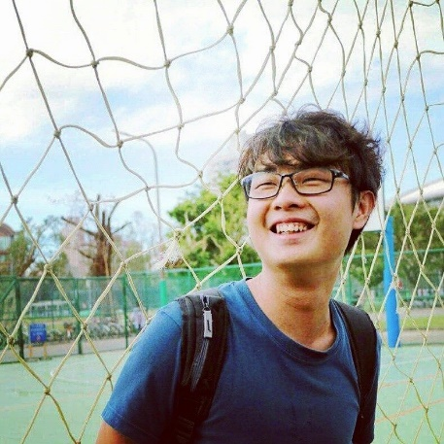
Self-Introduction and Experience Sharing
黃彥鈞 Weber Huang
Master student of Data Science, TMU

Slide 2
Outlines
Background
Experiences
What I am interested in

Slide 3
Background 1/2
Education
Bachelor of Library and Information Science, National Taiwan University (NTU)
Related course
Organization of Information, Reference and Information Services , Information Retrieval, Database Management System, Introduction of Data Science
Seminar paper
2018 台灣政治學會年會 暨「變動中的大國關係與民主治理」國際學術研討會
台北市長候選人臉書經營方式的影響分析
Hobbies
Classical Guitar, Cycling, Hiking, Swimming, Gaming

Slide 4
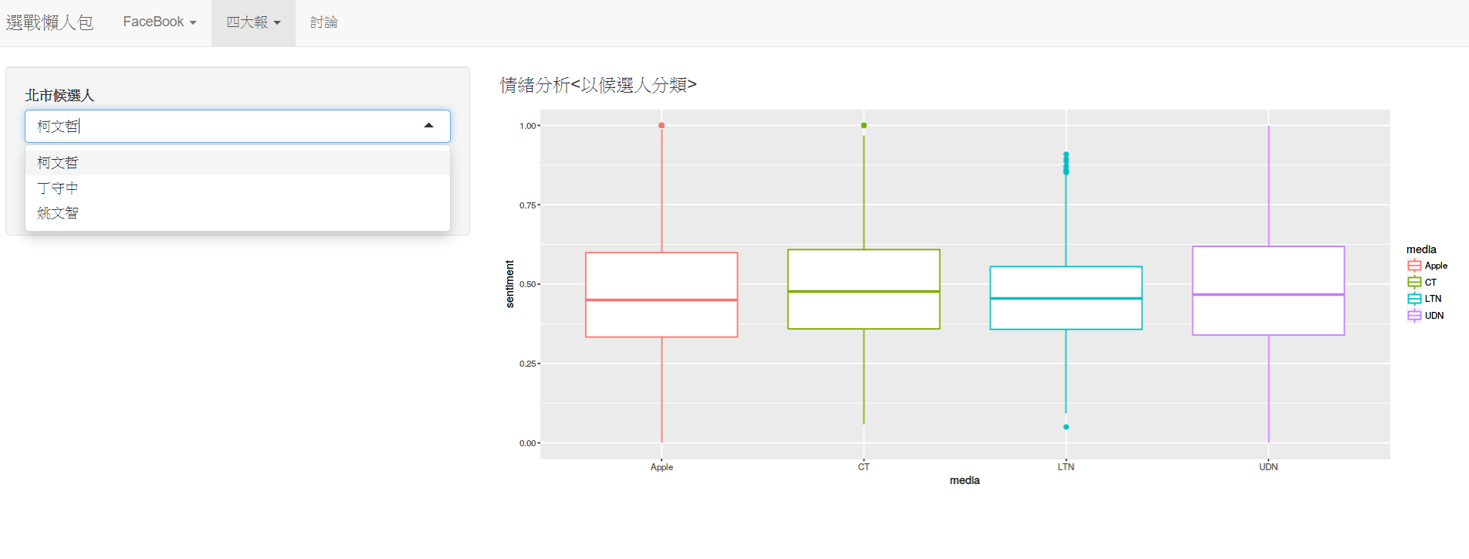
Background 2/2

Slide 5
Working experiences
Internship of Data Service Department (2017)
Intellectual Property Office (IPO)
Assistant Data Analyst (2019)
Raphael Inc.

Slide 6





Learning experiences
Database
Data Analytics
Visual Analytics
MySQL Workbench
R
Python
Google Analytics
Tableau

Slide 7
What I am interested in
Machine learning and deep learning in medical application
Text mining for precision medicine
Artificial Intelligence for cybersecurity

Slide 8
Thanks for listening!!!

